Slide 1
Adaptive Slow Motion for Videos
Semester Project
Loïc Barben

Slide 2
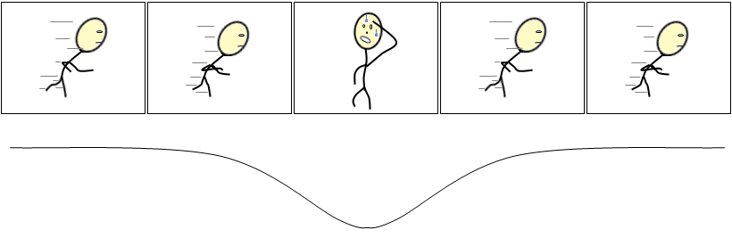
Introduction
Videos have dynamism
Dynamism : speed of objects or camera
Goal : adapt video play time to the dynamism of the scene
motion
time

Slide 3
Plan
Kinds of Optical Flows and their applications
Approaches and the one chosen
Implementation of my solution
Results

Slide 4
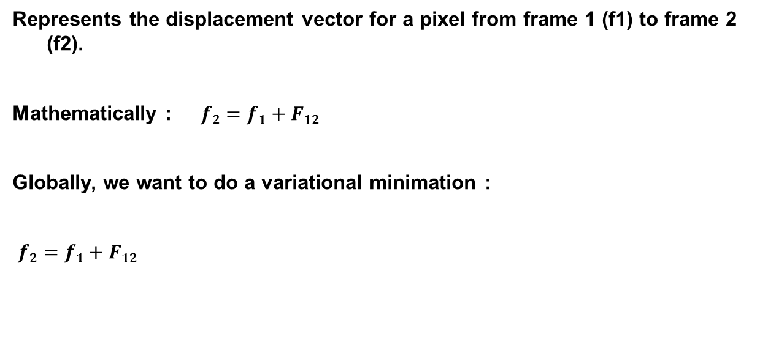
Optical flow
Represents the displacement vector for a pixel from frame 1 (f1) to frame 2 (f2).
Mathematically : $f2=f1+F12$
Globally, we want to do a variational minimation :
$f2=f1+F12$

Slide 5
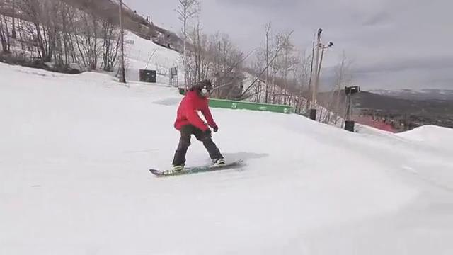
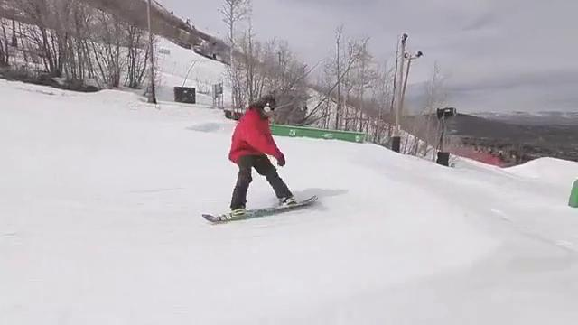
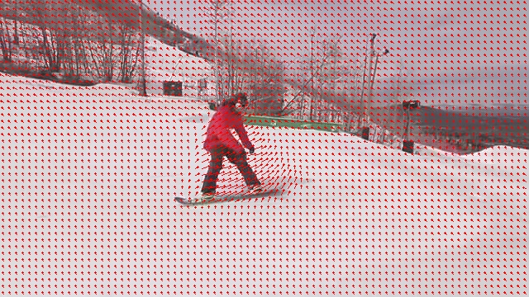
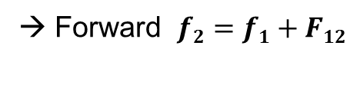
Optical flow
→ Forward $f2=f1+F12$
Flow
Frame 1
Frame 2

Slide 6
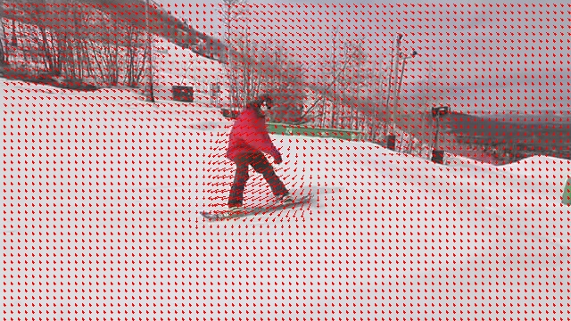
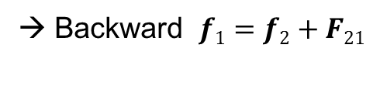
Optical flow
→ Backward $f1=f2+F21$
Flow
Frame 2
Frame 1

Slide 7
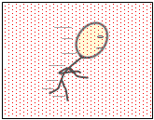
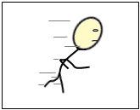
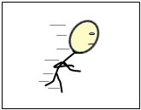
Optical flow
multi-frames (or 2nd order)
F13
F12
F23
f1
f2
f3

Slide 8
Optical flow
→ methods
Several methods, tried or implemented :
Ce Liu (CPU)
Farneback (CPU)
Brox (GPU)
Others (not presented)

Slide 9
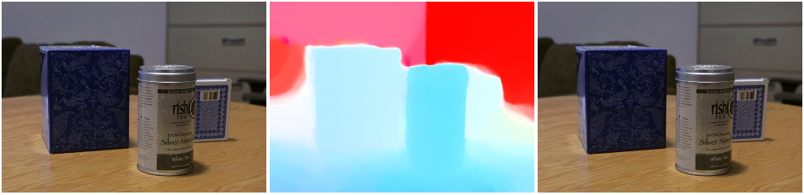
Optical flow
→ Ce Liu*
Different approach than others : Minimization : IRLS vs VO
+ : better quality, mutli channels support (r,g,b)
- : a bit slow, c++ code broken somewhere
* LIU, C. Beyond pixels: Exploring new representations and appli-
cations for motion analysis. Tech. rep., Doctoral Thesis. Mas-
sachusetts Institute of Technology.

Slide 10
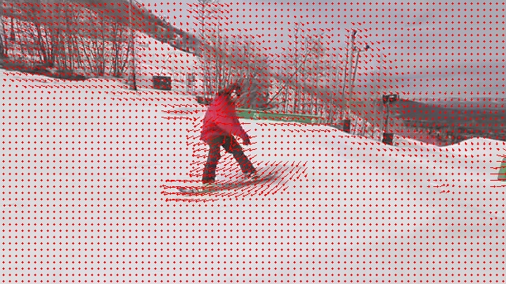
Optical flow
→ Farneback (OpenCV)

Slide 11
Optical flow
→ Brox (OpenCV)

Slide 12
Optical flow
→ Comparison : Farneback vs Brox
Farneback (CPU, performance settings)
Brox (GPU, performance settings)
Fastest, if GPU not good
Easiest to tune
Better quality in general
Suit well for interpolation

Slide 13
approach
Particle Video
CC Toolbox
Graph-based hierarchical object segmentation
Own solution

Slide 14
Approaches
→ Object segmentation
Idea : segment objects, find their motion, remap the video time accordingly.
Use : Particle Video, CC toolbox, Hierarchical graph base segmentation

Slide 15
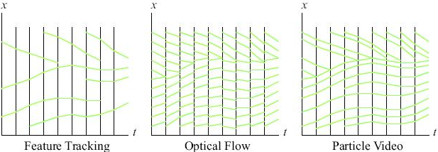
Approach
→ Particle Video*
Or Long-Range Motion Estimation Using Point Trajectories
* SAND, P., AND TELLER, S. J. 2006. Particle video: Long-range
motion estimation using point trajectories. In CVPR (2), IEEE Computer Society, 2195–2202.

Slide 16
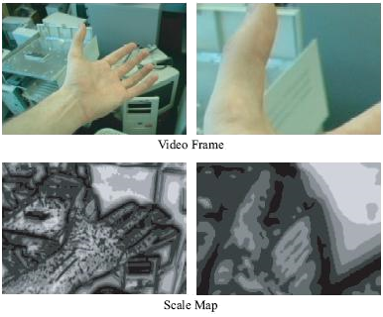
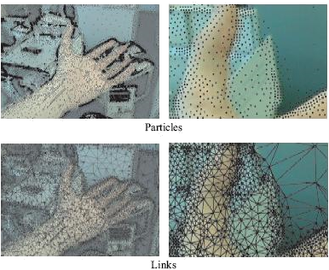
Approach
→ Particle Video
1
2
3
4

Slide 17

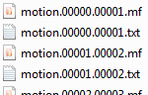
Approach
→ Particle Video
Video input (7 sec)
Motion information (.mf + .txt files, 892 MB of data)
→ About 5h of computation at 3.7Ghz
Processed into a .sps (26MB) file
(171524 tracked points)

Slide 18
Approach
→ Particle Video
Video
7 sec, 492x360
9 sec, 960x540
Output size
897 MB
136 MB
Tracked Points
5h10
51min, failed
10 sec, 1280x720
23 sec, 640x360
1.43 GB
> 729 MB
Computation time
97’051
7h46
> 8h
171’524
2’590
102’325
null
Format : [start frame] [end frame] [p.x p.y] [p.x p.y] …

Slide 19
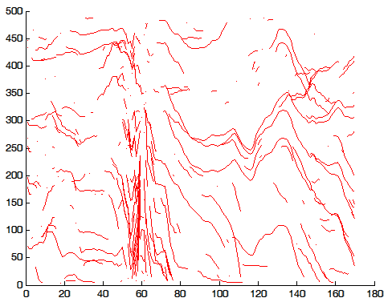
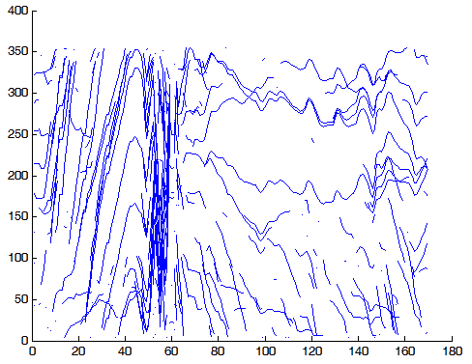
Approach
→ Particle Video
Uniform sampling (250/171052)
Y : width
Y : height
null
X : frames number 1-169

Slide 20
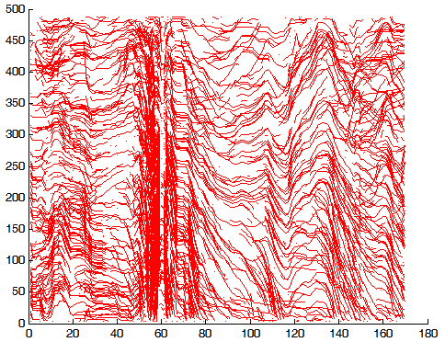
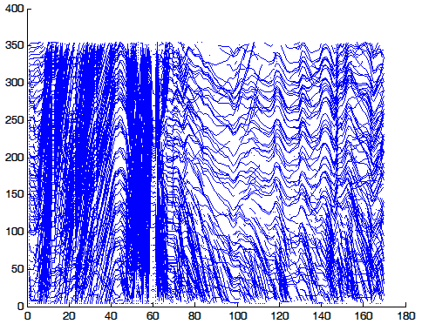
Approach
→ Particle Video
Uniform sampling (2500/171052)
Y : width
Y : height
null
X : frames number 1-169

Slide 21
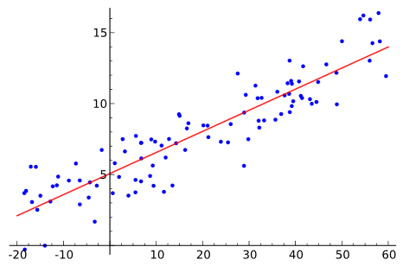
Approach
→ Particle Video → CCToolbox*
Tool for clustering curves using Matlab.
Need to convert to output of Particle Video in Matlab format.
Clustering parameters :
K = 3
Method = Linear Regression
wikipedia
* GAFFNEY, S. J. 2004. Probabilistic curve-aligned clustering and prediction with regression mixture models. Tech. rep., Ph.D. Dissertation, 2004. Laboratoire MAS.

Slide 22
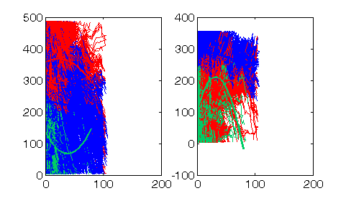
Approach
→ Particle Video → CCToolbox
For 171’524 tracked points :
width
height

Slide 23
Approach
→ Particle Video → CCToolbox
But,
Particle Video :
Way too slow to work with.
Need to reduce the number of tracking points.
Too much parameters to tune to be right.
CCToolbox :
How to find K ?
Again not fast.
Conclusion : would need too much time to get it right.

Slide 24
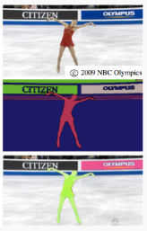
Approach
→ Graph-based video segmentation*
Idea :
Segment objects using this video oriented tool.
Use the optical flow to find the speed of the objects
Remap the time
http://www.cc.gatech.edu/cpl/projects/videosegmentation/
* GRUNDMANN, M., KWATRA, V., HAN, M.,ANDESSA, I. A. 2010. Efficient hierarchical graph-based video segmentation. In IEEE CVPR, 2141–2148.

Slide 25
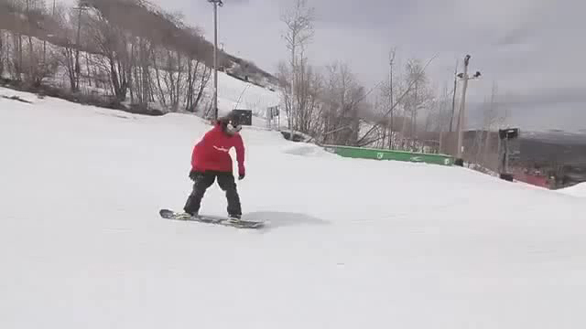
Approach
→ Graph-based video segmentation*

Slide 26
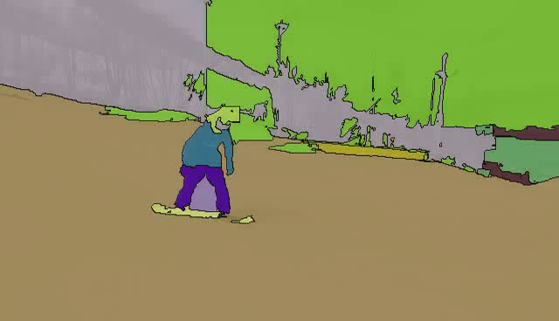
Approach
→ Graph-based video segmentation*
Rendered movie at 90% of highest hierarchy level, 85% alpha, borders highlighted.

Slide 27
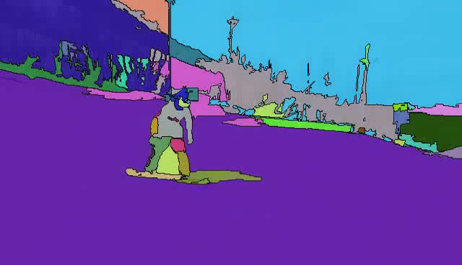
Approach
→ Graph-based video segmentation*
Rendered movie at 70% of highest hierarchy level, 85% alpha, borders highlighted.

Slide 28
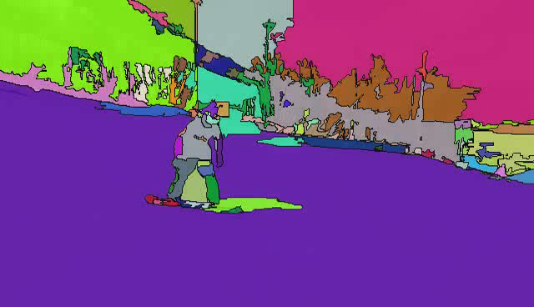
Approach
→ Graph-based video segmentation*
Rendered movie at 50% of highest hierarchy level, 85% alpha, borders highlighted.

Slide 29
Approach
→ Graph-based video segmentation*
Advantages :
+ seems to work very well
+ fast
+ customizable
Disadvantages :
No framework, only a web interface
need to provide a hierarchy level for the optimal settings
Could have been the approach taken.

Slide 30
Approach
→ Own solution
Idea :
Use directly the information of the optical flow to determine the dynamism.
In short, we want to have a number that quantify the motion between two consecutive frames.
Draw a graph of the motion over time.
Remap accordingly.

Slide 31
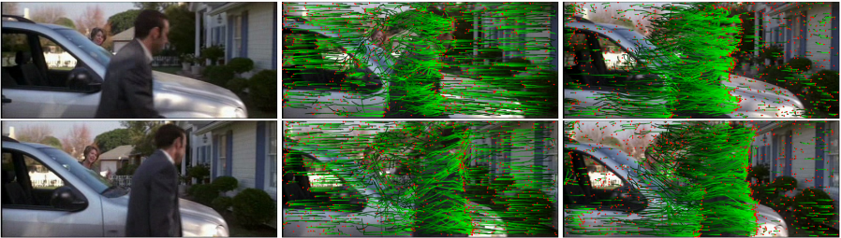
Approach
→ ω-flow* → Own solution
Problem : camera movement.
Solution : work with ω-flow :
Optical flow
ω-flow
* JAIN, M., JEGOU, H., AND BOUTHEMY, P. 2013. Better ex-ploiting motion for better action recognition. In CVPR, IEEE, 2555–2562
http://www.irisa.fr/texmex/people/jain/w-Flow/

Slide 32
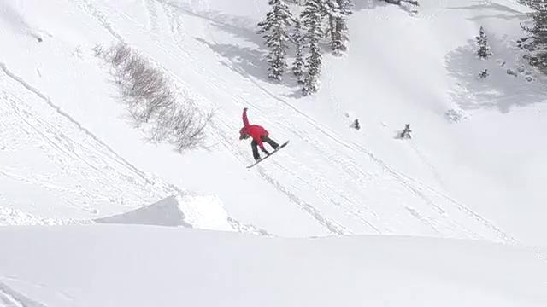
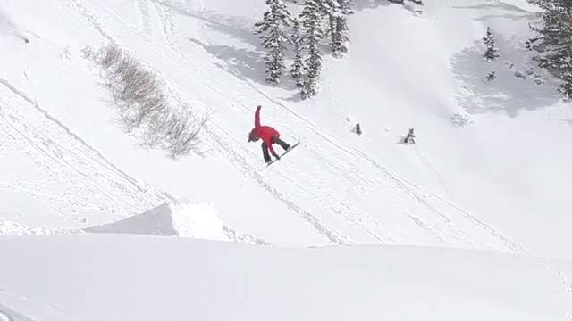
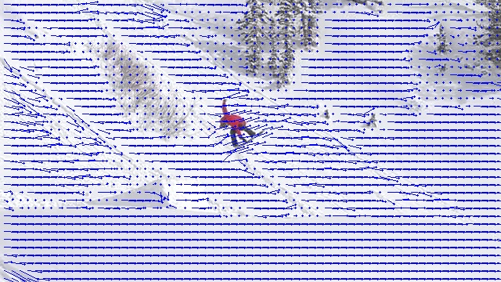
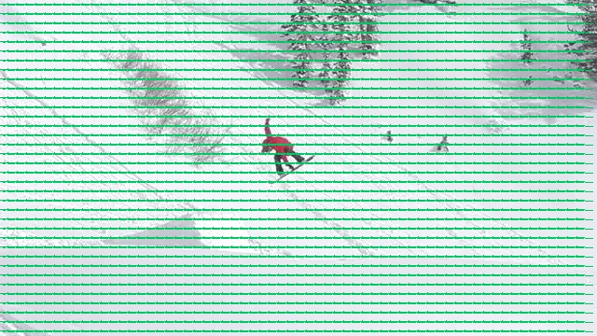
Approach
→ ω-flow → Own solution

Slide 33
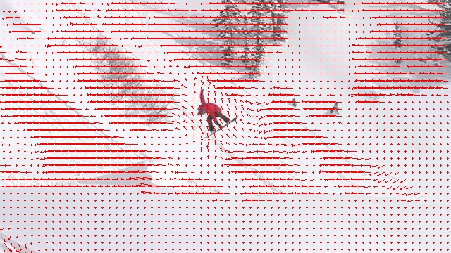
Approach
→ ω-flow → Own solution
-
ω-flow
Optical flow
Affine flow
=

Slide 34
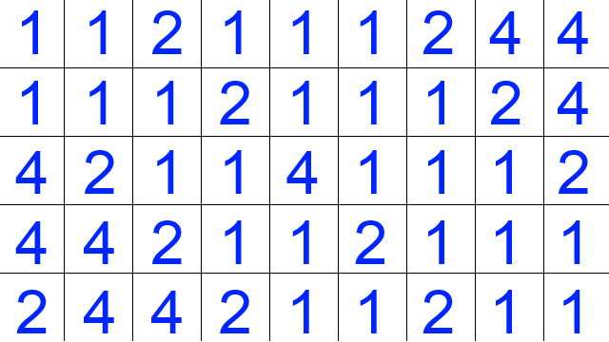
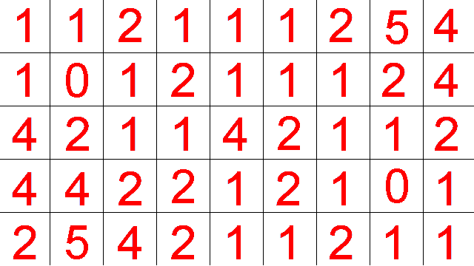
Implementation
→ Clustering
x
Displacement map
y

Slide 35
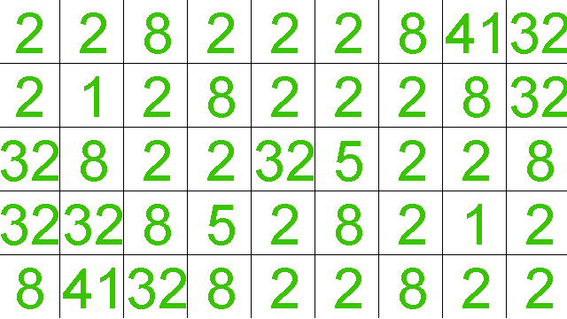
Implementation
→ Clustering
Squared norm
Displacement map

Slide 36
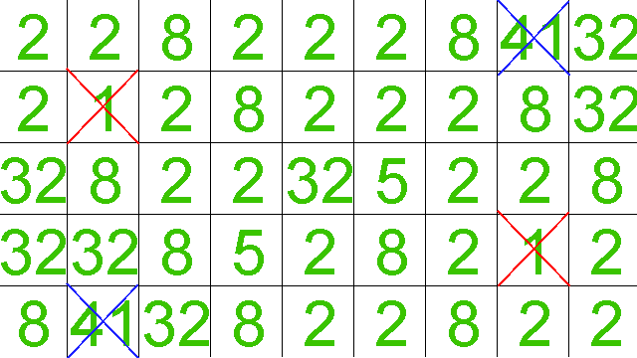
Implementation
→ Clustering
Eliminate
-Background values
-Too high values
order
4.9 – 4.4 > 0.2
Parameters :
_minThreshold = 1.5
_maxThreshold = 40
_minDistInCluster = 0.2
C1
C2
C3

Slide 37
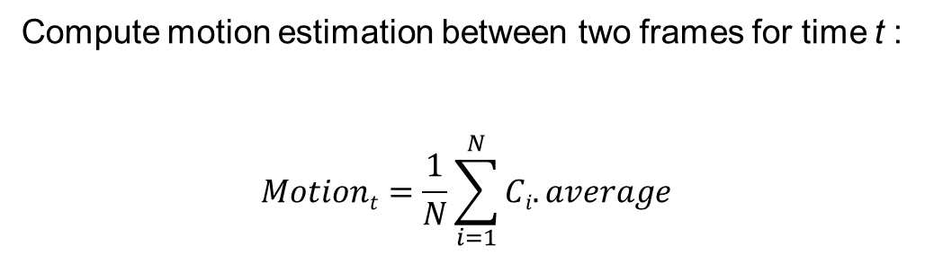
Implementation
→ Motion estimation
Compute motion estimation between two frames for time t :
$$Motiont=\frac{1}{N}\sum_{i=1}^{N}{Ci.average}$$

Slide 38
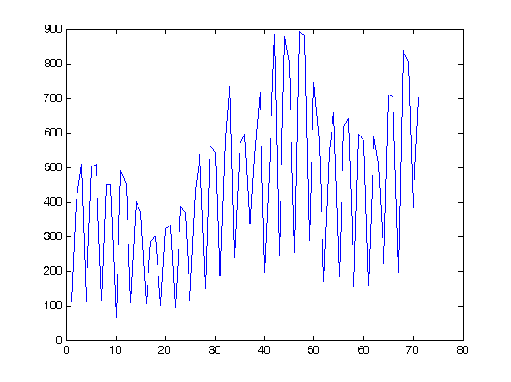
Implementation
→ Motion estimation
The optical flow values are not perfect and strongly depends on the video quality.
For example, MPEG-4 videos are decoded using I/P/B frames : some frames are drawn by interpolation. It is thus possible to have an in-between frame that is not exactly the one we expect.
That’s why we can get this :
Motion estimation
Frame number (72)

Slide 39
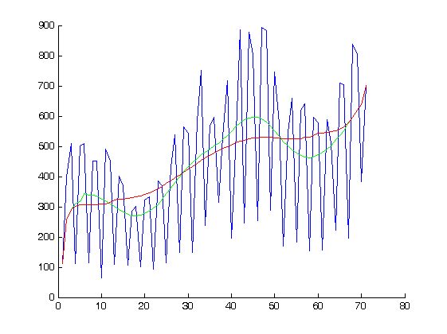
Implementation
→ Motion estimation
Need to smooth the data (running average) :
_window_size :
10
24
Motion estimation
Frame number (72)

Slide 40
Implementation
→ Spline
Load data into a timeline for time remapping.
Questions :
How to express the dynamism ?
How to present the data in an intuitive way ?
How to reencode the video based on the previous representation ?

Slide 41
Implementation
→How to express the dynamism ?
Compute the mean μ of the data set.
Compute the ratio relatively to the average.
Represent the data with the help of a spline.

Slide 42
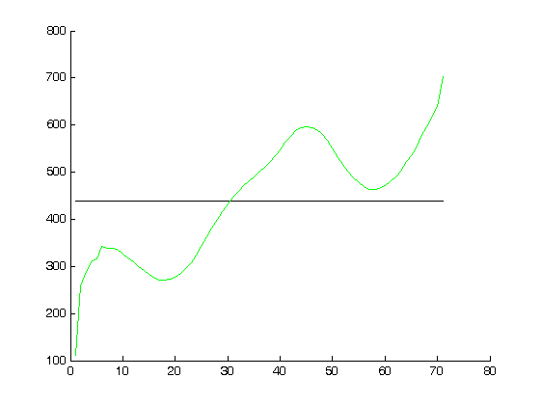
Implementation
→How to express the dynamism ?
Compute the mean μ of the data set.
Compute the ratio relatively to the average.
Represent the data with the help of a spline.
Motion estimation
μ
Frame number (72)

Slide 43
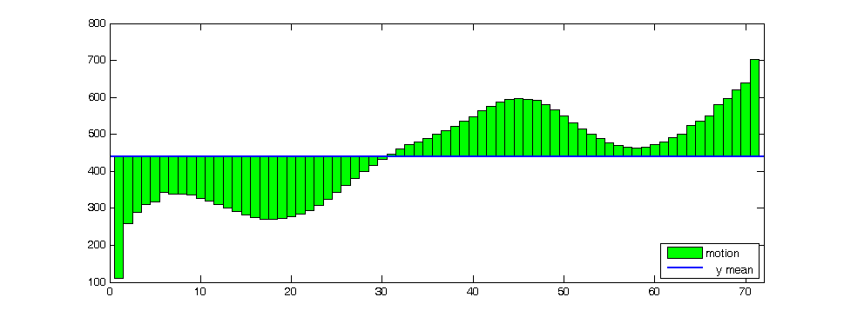
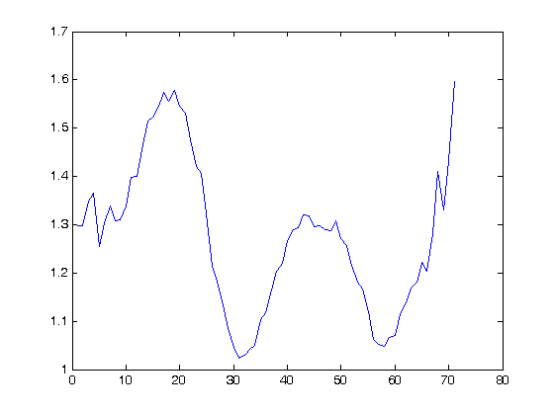
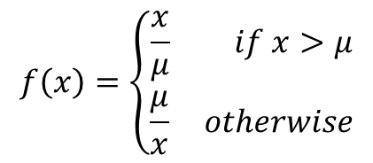
Implementation
→How to express the dynamism ?
Compute the mean μ of the data set.
Compute the ratio relatively to the average.
Represent the data with the help of a spline.
$$f\left(x\right)=\left\{\begin{aligned}\frac{x}{μ} if x>μ \\ \frac{μ}{x} otherwise\end{aligned}\right.$$

Slide 44
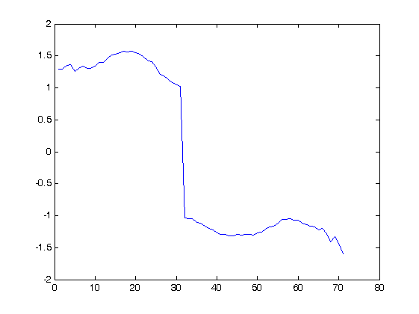
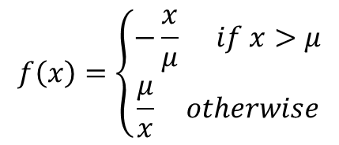
Implementation
→How to express the dynamism ?
Compute the mean μ of the data set.
Compute the ratio relatively to the average.
Represent the data with the help of a spline.
$$f\left(x\right)=\left\{\begin{aligned}−\frac{x}{μ} if x>μ \\ \frac{μ}{x} otherwise\end{aligned}\right.$$

Slide 45
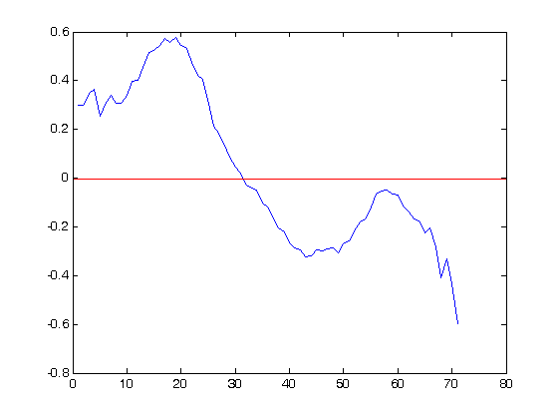
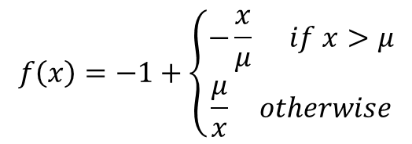
Implementation
→How to express the dynamism ?
Compute the mean μ of the data set.
Compute the ratio relatively to the average.
Represent the data with the help of a spline.
$$f\left(x\right)=−1+\left\{\begin{aligned}−\frac{x}{μ} if x>μ \\ \frac{μ}{x} otherwise\end{aligned}\right.$$

Slide 46
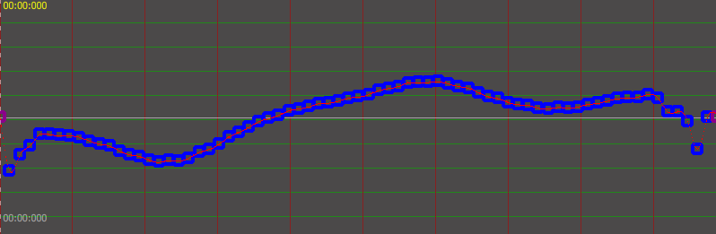
Implementation
→How to present the data ?
Compute the mean μ of the data set.
Compute the ratio relatively to the average.
Represent the data with the help of a spline.

Slide 47

Implementation
→How to present the data ?
Compute the mean μ of the data set.
Compute the ratio relatively to the average.
Represent the data with the help of a spline.
Remove outliers with Chauvenet’s criterion and interpolate nearby values.

Slide 48

Implementation
→How to present the data ?
Compute the mean μ of the data set.
Compute the ratio relatively to the average.
Represent the data with the help of a spline.
Remove outliers with Chauvenet’s criterion and interpolate nearby values.

Slide 49

Implementation
→How to present the data ?
Compute the mean μ of the data set.
Compute the ratio relatively to the average.
Represent the data with the help of a spline.
Reduce the control points number using Least-Squares fitting.

Slide 50











Implementation
→How to reencode the video ?
factor
0.2
0.7
0.55
0.5
f2
0.3
Accumated ratio :
0.4
f1
f2
0.0
$$+ F∗0.0$$
$$+ F∗0.3$$
$$+ F∗0.7$$
0.3
f1
timeline
100ms
112ms
128ms
148ms
$$100+40∗0.3$$
$$100+40∗0.7$$
$$140+40∗0.2$$

Slide 51
Implementation
→ Interpolation factors

Slide 52

Implementation
→ Interpolation factors
Th duration of the video is changed.

Slide 53

results

Slide 54



results
minDistBetweenValues : 0.25, minClusterSize : 100, Background : 0.5
4x
minDistBetweenValues : 1.75, minClusterSize : 100, Background : 0.75

Slide 55

results

Slide 56


results
minDistBetweenValues : 0.5, minClusterSize : 10, Background : 0.5

Slide 57

results
minDistBetweenValues : 0.5, minClusterSize : 10, Background : 0.5

Slide 58


results
minDistBetweenValues : 1, minClusterSize : 100, Background : 0.1

Slide 59

results
minDistBetweenValues : 1, minClusterSize : 100, Background : 0.1

Slide 60


results
minDistBetweenValues : 0.5, minClusterSize : 10, Background : 0.5

Slide 61

results
minDistBetweenValues : 0.5, minClusterSize : 10, Background : 0.5

Slide 62


results
minDistBetweenValues : 0.5, minClusterSize : 10, Background : 0.5

Slide 63

results
minDistBetweenValues : 0.5, minClusterSize : 10, Background : 0.5

Slide 64
results
Conclusion :
Good result if the video
is in not too long (typically < 10sec)
optical flow of good quality
scene remains the same
Future work :
Extensible search of the optimal parameters.
More investigation on the meaning of the parameters.
Automatically cut long scenes in short sequences.
(Hire people to work with me.)

Slide 65


Software

Slide 66


Software

Slide 67
Questions ?
Thank you !

